Slide 1
John Burden
Introduction to the
Measurement Layout Framework
Vancouver, 20 February, 2024
Leverhulme Centre for the Future of Intelligence, University of Cambridge,
Notes:
Measurement Layouts for Capability-oriented AI Evaluation John Burden1, Marko Teˇsi ́c1, Konstantinos Voudouris 1, Lucy Cheke 1, Jos ́e Hern ́andez-Orallo
Introduction Time: 15 Minutes. Presenters: Full Team This short opening will consist of the Lab team introduc- ing themselves to the participants. We will likewise encour- age participants to introduce themselves and their research interests to the rest of the Lab attendees. The agenda and goals of the lab will be briefly explained. Motivating Capability-oriented Evaluation Time: 20 minutes. Presenter: Jos ́e Hern ́andez-Orallo This session will establish the motivation for what we refer to as capability-oriented evaluation. We will begin with a discussion of the limitations of current AI evaluation practices, especially for changing distributions and general- purpose AI. We will identify robust experimental practices from the cognitive sciences that can address the shortcom- ings of AI evaluation. Specifically, we will frame task per- formance as a function of task demands and system capabili- ties. This framing, when combined with appropriate domain knowledge regarding the requirements for success within a task, allows us to estimate actual capabilities that are inde- pendent of the distribution of the task’s test-set. This requires two inferences, a backwards estimation of the capabilities from test results and task demands, and a forwards inference of predicted performance from the capabilities and the de- mands of new tasks.

Slide 2
This Session
Introducing the Measurement Layout Framework:
What are they?
How are they used?
Why do we think they can provide capability-oriented evaluation?
Hands on experience learning to construct them.

Slide 3
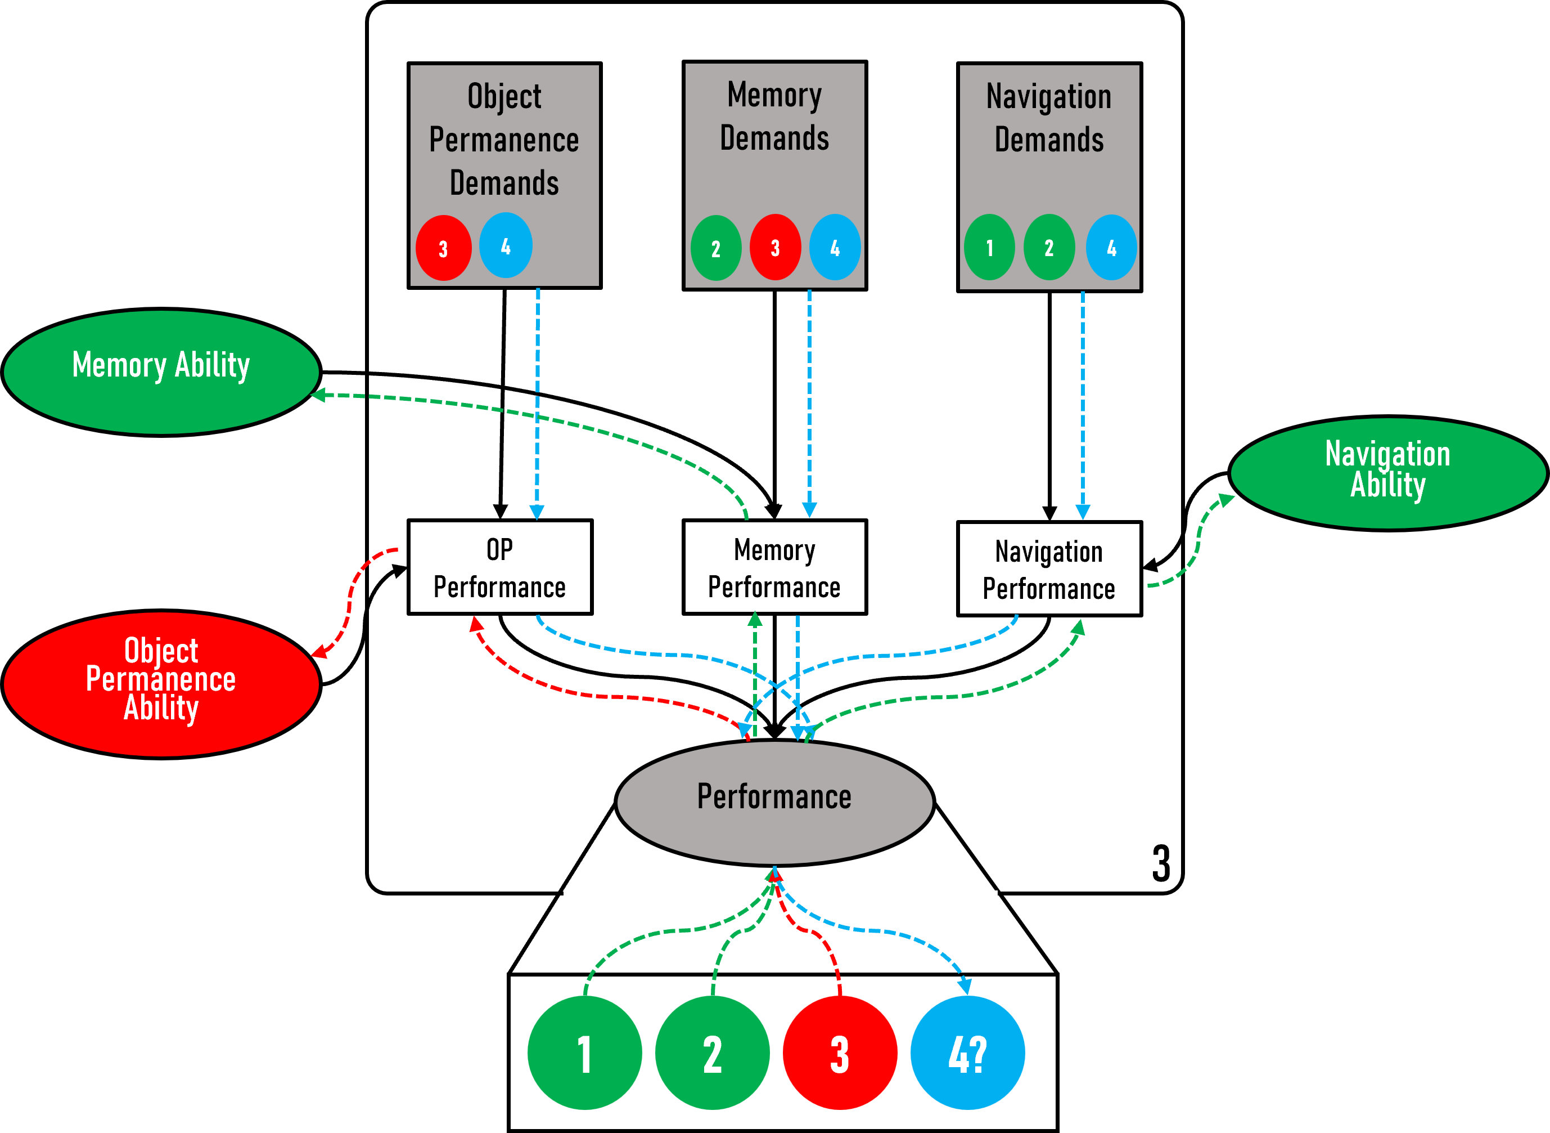
Measurement Layouts – The What.
If we know the demands of a set of tasks or task instances and how they are related, we can build a Bayesian model that connects system capabilities and task demands.
From a collection of instances, we can infer capabilities.
Then we can predict future performance for new instances.

Slide 4
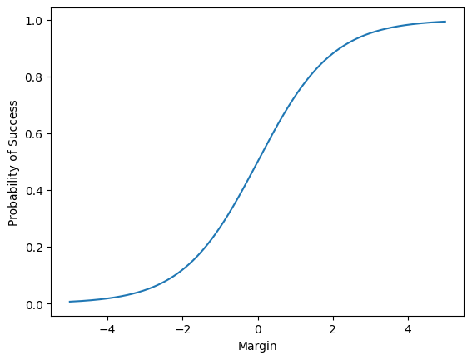
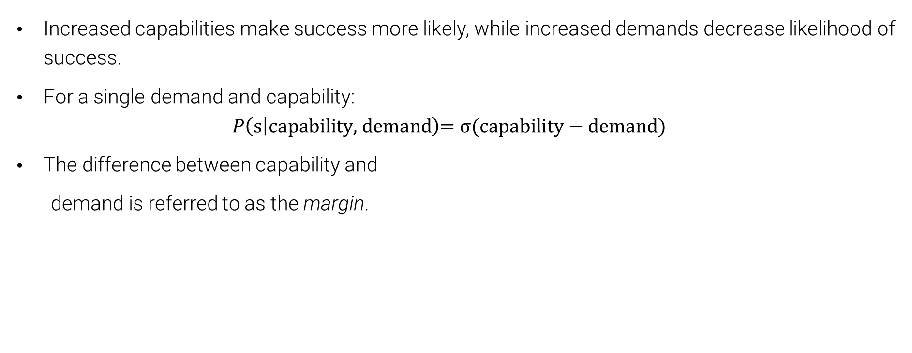
Measurement Layouts – The What
Increased capabilities make success more likely, while increased demands decrease likelihood of success.
For a single demand and capability:
$$P\left(\text{s} | \text{capability}\text{, }\text{demand}\right)\text{= }\text{σ}\text{(}\text{capability}\text{ − }\text{demand}\text{)}$$
The difference between capability and
demand is referred to as the margin.

Slide 5
Measurement Layouts – The What
More than a single ability and demand.
Introduce partial performance nodes.
Final performance will depend on some combination of these.

Slide 6
Measurement Layouts – The What
The connective structure between nodes can encode knowledge about the task.
Complex connective structure can arise from the need to accurately distinguish between success, failure, confounding behaviour.
We refer to the function describing these relationships as Linking Functions.
LFs inform how partial performance is assessed.

Slide 7
Measurement Layouts – The What
LFs also inform how partial performances are combined to give final performance.
Some tasks will be non-compensatory. High capabilities in one area will not compensate for lacking in others.
Some tasks compensatory. One high capability can compensate for low levels in others

Slide 8
Measurement Layouts – The How
So, we have the structure of a measurement layout in place. What do we do with it?
Need a data-set with performance outcomes labelled along with demands for each instance.
Bayesian model needs priors
Either encode system knowledge or uninformative.
We can then leverage a probabilistic programming implementation of the network using PyMC.

Slide 9
Measurement Layouts – The Why
Why do we expect Measurement Layouts to help provide capability-oriented evaluation.
Capabilities are independent of the distribution of tasks instances
Allows us to predict future performance at the instance-level. The Measurement Layout models reflect domain expertise
Higher internal validity.
Enables predictions to be valid even out of distribution.

Slide 10
Exploring Measurement Layouts in PyMC
https://github.com/Kinds-of-Intelligence-CFI/measurement-layout-tutorial

